Slide 1
Group 6
Tracy Allison
Crystina Cho
Anastasia Finch
INFO 284-10
Professor Scott
Spring 2016

Slide 2
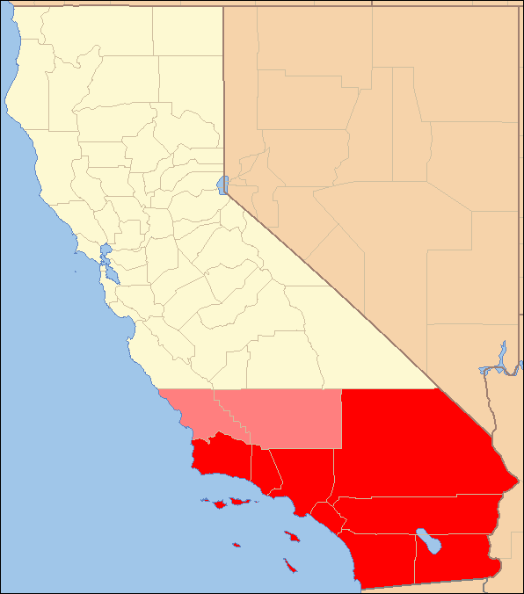
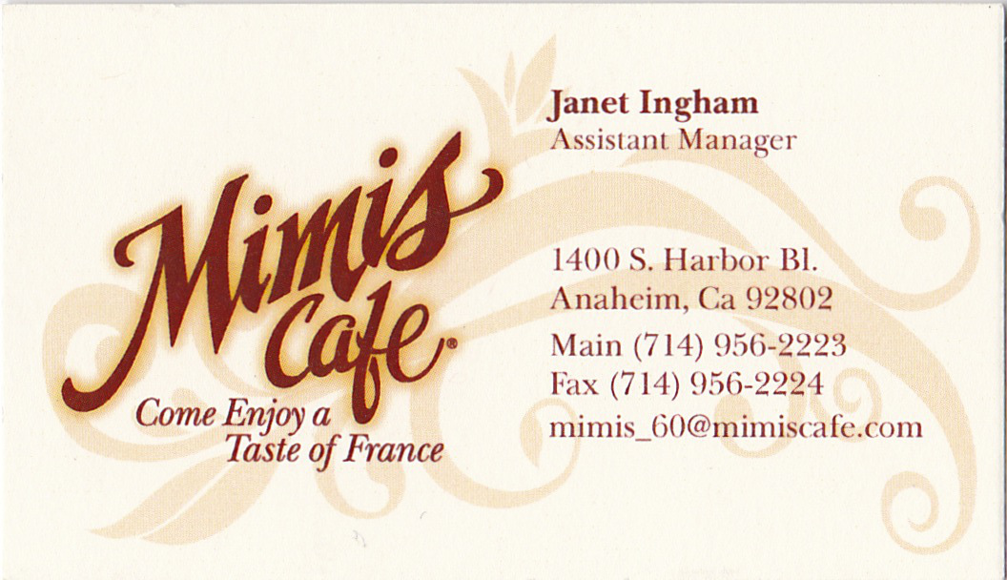
Ephemera of Southern California

Slide 3
Standards
Two-dimensional, paper based objects only
From locations in the Southern California region
600 dpi, 24-bit color archival TIFF
CONTENTdm converted to JPEG

Slide 4
Copyright
Digitized under Fair Use, Title 17 of the United States Code § 107
Collection presented for educational, noncommercial uses only
Group 6 does not hold the copyright and does not profit from the images
Users are responsible for determining copyright status and seeking permission for usage

Slide 5
Metadata
13 metadata fields used
4 fields used controlled vocabularies
6 default CONTENTdm fields were deleted
3 custom fields were added

Slide 6
Metadata Fields Used
Title
Subject
Description
Publisher - Controlled Vocabulary
Location - Controlled Vocabulary
Date
Type - Controlled Vocabulary
Format
Dimensions
Digitization Specifications
Source
Language - Controlled Vocabulary
Rights

Slide 7
Problems Encountered
Learning curve with ContentDM
Uploading and editing items
Deleting compound items
Technical difficulties with scanner capabilities not meeting needs
Auto-cropping
Moiré pattern
Incorrect color reproduction

Slide 8
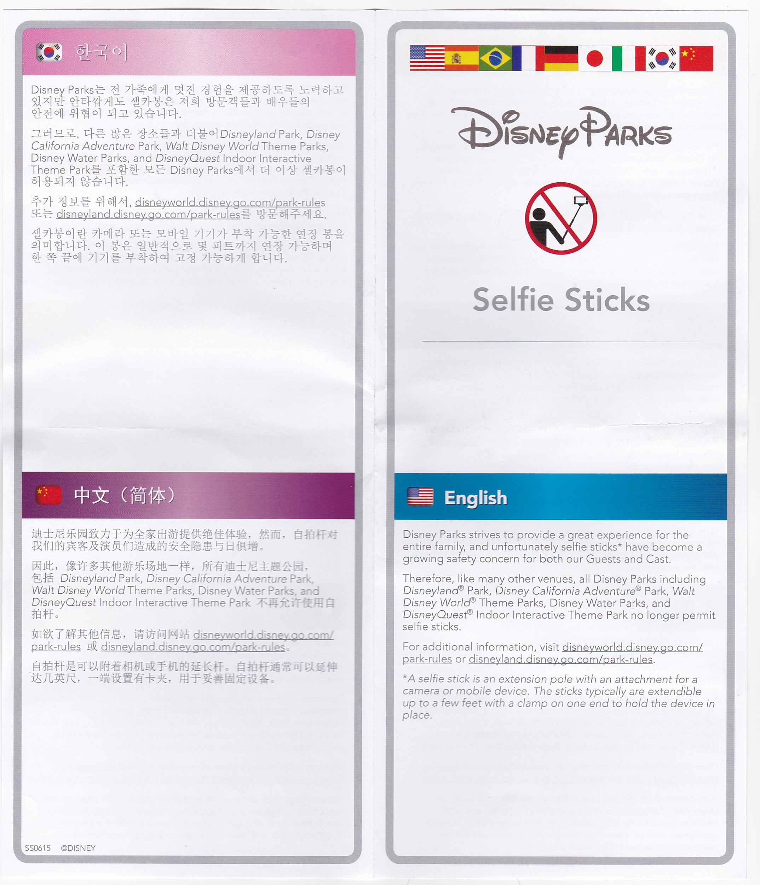
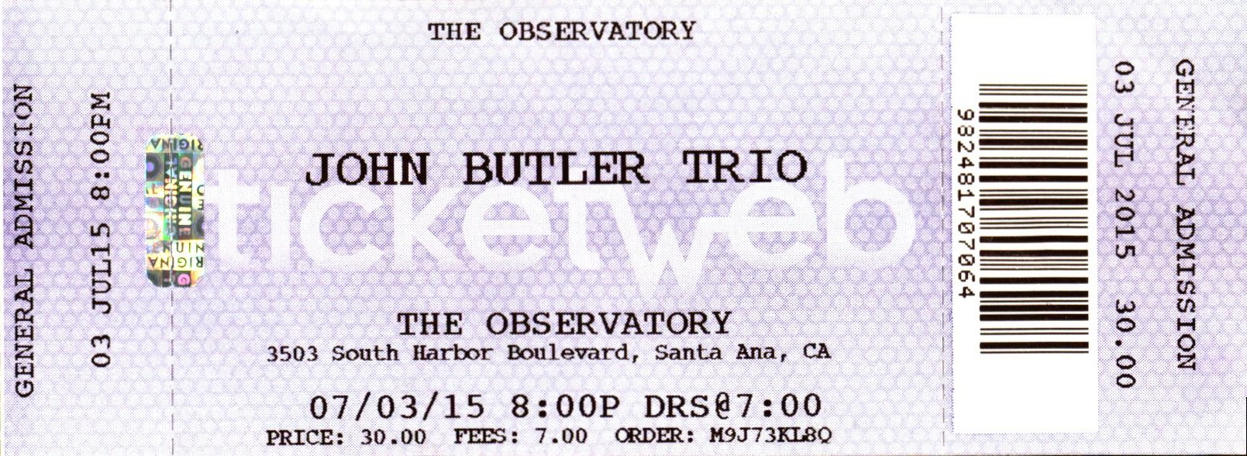
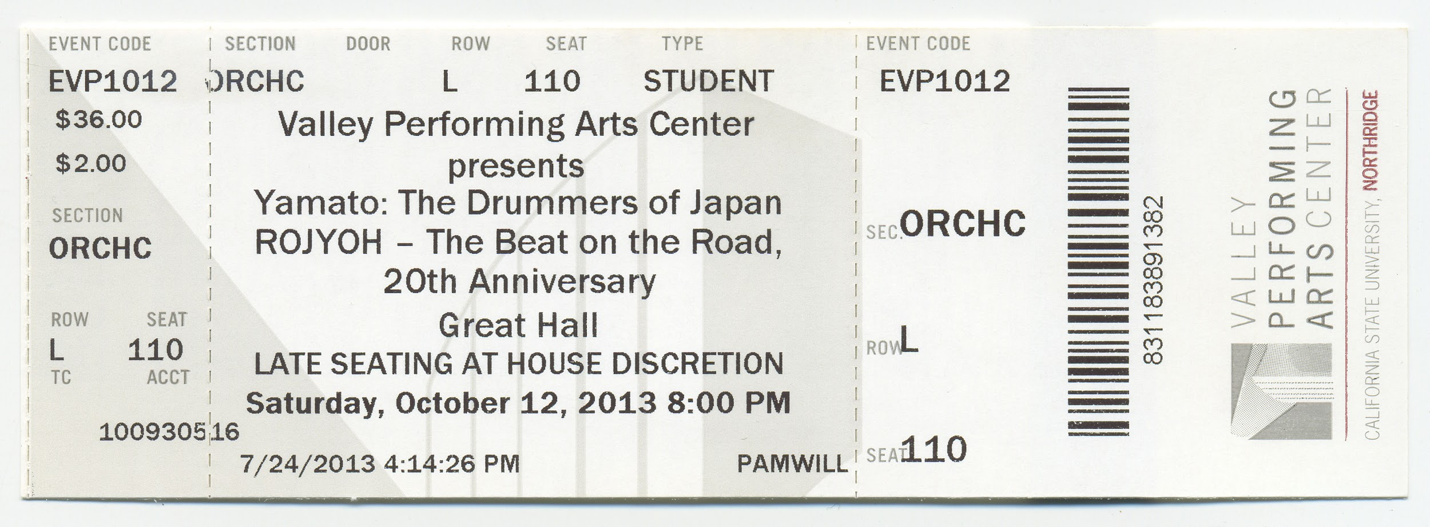
Sample Records

Slide 9
Metadata
Title: John Butler Trio Ticket
Subject: Concert Ticket for John Butler Trio show
Description: The front of this ticket gives information about a concert given by John Butler Trio at The Observatory on 3503 South Harbor Boulevard, Santa Ana, CA on 07/03/15 at 8:00 PM. The doors opened at 7:00 PM. It was $30.00 for a general admission ticket with $7.00 in fees. This ticket is printed in black ink on a colored background.
Publisher: Ticketweb
Location: Santa Ana, CA
Date: 2015-07-03
Type: Ticket
Format: Black ink printed on a colored background on perforated cardstock.
Dimensions: 14 x 5 cm
Digitization Specifications: Xerox DocuMate 700, 600 dpi, 24-bit
Source: Personal keepsake collection of Tracy Allison
Language: en
Rights: The images in this collection presented by INFO 284 Section 10 Group 6 are for non-profit educational and scholarship purposes only in accordance to Title 17 of the United States Code § 107: Limitations on exclusive rights: Fair Use. Group 6 does not hold the copyright to these images and does not profit from their use in any way. These images may be protected by United States Copyright Laws and cannot be reproduced, published, or distributed beyond the scope of fair use without the expressed permission of the copyright holder(s). Users of this collection are exclusively responsible for determining copyright status and obtaining the necessary permissions for usage beyond the scope of fair use.

Slide 10
Title: Valley Performing Arts Center Ticket Subject: Ticket for admittance to see a live performance at the Valley Performing Arts Center Description: Ticket for the live performance of "Yamato: The Drummers of Japan ROJYOH - The Beat on the Road, 20th Anniversary" at 8:00 pm on Saturday October 12, 2013 at the Valley Performing Arts Center (VPAC). The ticket is for the orchestra section, row L, seat 110 and cost $36.00. The front of the ticket has black text printed with a light-gray watermark of the VPAC behind. The back of the ticket contains terms and disclaimers.
Publisher: Valley Performing Arts Center (VPAC) Location: Northridge, CA Date: 2013-10-12 Type: Ticket Format: Color print on cardstock. Dimensions: 14.5 x 5 cm Digitization Specifications: Epson Perfection V100 Photo scanner, 600 dpi, 24-bit. Source: Personal collection of Crystina Cho Language: en Rights: The images in this collection presented by INFO 284 Section 10 Group 6 are for non-profit educational and scholarship purposes only in accordance to Title 17 of the United States Code § 107: Limitations on exclusive rights: Fair Use. Group 6 does not hold the copyright to these images and does not profit from their use in any way. These images may be protected by United States Copyright Laws and cannot be reproduced, published, or distributed beyond the scope of fair use without the expressed permission of the copyright holder(s). Users of this collection are exclusively responsible for determining copyright status and obtaining the necessary permissions for usage beyond the scope of fair use.

Slide 11
Metadata
Title: DisneyParks Selfie Sticks Notice
Subject: DisneyParks Selfie Sticks Notice
Description: This is a pamphlet describing the Disney Parks policy of selfie sticks. The front has a drawing of a person holding a selfie stick with a red "No" symbol on top and the policy in English below. The inside and back has the policy repeated in multiple languages, including Spanish, Portuguese, French, Dutch, Japanese, Italian, Korean and Chinese.
Publisher: DIsneyParks
Location: Anaheim, CA
Date: N/A
Type: Pamphlet
Format: Color printed on paper
Dimensions: 19.5 x 23 cm
Digitization Specifications: Canon MG7500 scanner, 300 dpi, 24-bit
Source: Personal collection of Anastasia Finch
Language: en, es, fr, it, ja, ko, pt, sv, zh
Rights: The images in this collection presented by INFO 284 Section 10 Group 6 are for non-profit educational and scholarship purposes only in accordance to Title 17 of the United States Code § 107: Limitations on exclusive rights: Fair Use. Group 6 does not hold the copyright to these images and does not profit from their use in any way. These images may be protected by United States Copyright Laws and cannot be reproduced, published, or distributed beyond the scope of fair use without the expressed permission of the copyright holder(s). Users of this collection are exclusively responsible for determining copyright status and obtaining the necessary permissions for usage beyond the scope of fair use.

